Slide 1
BITS ZG553: Real Time Systems L10 – Real Time Operating Systems
K G Krishna
WILP Division, BITS-Pilani, Hyderabad

Slide 2

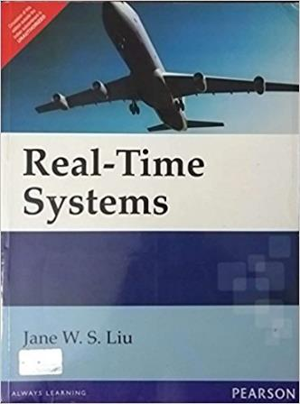
Text Book / References
Reference (R1)
Text Book (T1)
Note: As the above two books focus on theoretical treatment of the subject, Students are strongly advised to refer to web sources / MOOCs videos / library within their own organizations for more practical understanding of the topics.

Slide 3
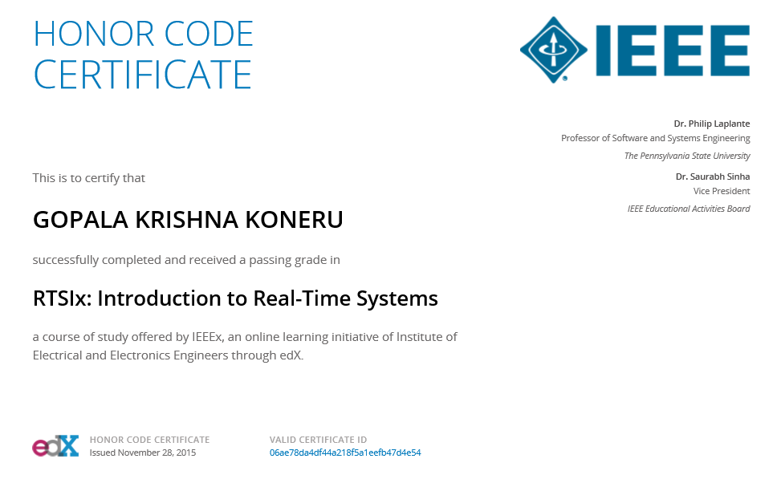
Excellent MOOCs Videos
(Coursera, edX,…)

Slide 4
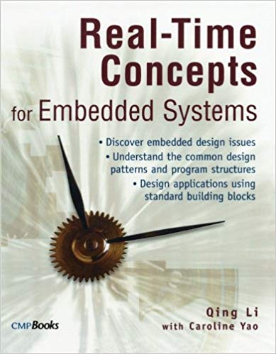
RTS Primer – For Light Reading

Slide 5
L-10: Real Time Operating Systems
[Ref: Notes/PPT]
Note: Students are requested to NOT to rely on PPTs/Recorded sessions as their only source of knowledge, explore sources within your own organization or web for any specific topic; attend classes regularly and involve in discussions;
PLEASE DO NOT PRINT PPTs, Save the Environment!
Source PPT Courtesy: Some of the contents of this PPT is sourced from Presentatoons of Prof K R Anupa / Prof B Mishra, BITS-Pilani WILP Division

Slide 6
Operating Systems
The operating system controls resources:
who gets the CPU;
when I/O takes place;
how much memory is allocated.
The most important resource is the CPU itself.
CPU access controlled by the scheduler.

Slide 7
Real Time Operating System
Real-time operating systems must provide three specific functions with respect to tasks:
scheduling
dispatching
intercommunication and synchronization
A scheduler determines which task will run next in a multitasking system
A dispatcher performs the necessary bookkeeping to start that task.
Inter-task communication and synchronization assures that the tasks cooperate.

Slide 8
Layers of Operating Systems
User Interface, Security Features, File Management etc
Operating System
Private Memory Blocks, I/O Services, Supporting Features etc
Executive
Inter-task Communication and Synchronization
Kernel
Task Scheduling and Despatching
Microkernel

Slide 9
Pseudokernels
Real-time multitasking in rudimentary form can be achieved without operating systems and interrupts.
These systems are known as pseudo-kernels.
In this approach, the resultant systems are often highly predictable.
Hence these are sometime preferred in low-end embedded systems.

Slide 10
Pseudokernels
System without O/S and Interrupt:
Polled Loop:
while (1)
{ /* do forever */
if (packet_here) /* check flag */
{
process_data(); /* process data */
packet_here=0; /* reset flag */
}
}
Pros:
Fast response
Cons:
Can fail due to burst of events
Generally not sufficient to handle complex systems
Waste of CPU time, especially when event being polled occurs infrequently

Slide 11
Pseudokernels
Polled Loop with Delay:
Used to treat a problematic events exhibiting Contact Bounce behaviour.
Any electromechanical switch can’t change its state instantaneously. It needs some time to settle down the oscillations. It is called Contact Bounce behaviour.
So a delay equal to the time little more than the contact bounce behaviour disappears, is introduced in the polled loop
In the following example, contact bounce behaviour disappears after 20 ms. So delay of 20 ms + 1 ms (to be on the safer side) = 21 ms is introduced.
while(1)
{ /* do forever */
if(flag) /* check flag */
{
process_event(); /* process event */
pause(21); /* wait 21 ms */
flag=0; /* reset flag */
}
}
Pros:
Excellent for high speed data channels, especially when the events occurs at widely dispersed intervals and CPU is dedicated to handle the data channel
Cons:
Can fail due to burst of events
Generally not sufficient to handle complex systems
Waste of CPU time, especially when event being polled occurs infrequently
The flag is set by an external device.
Delay (pause functionality) is generated by a timer.

Slide 12
Pseudokernels
Cyclic Code Structure:
while (1)
{ /* do forever */
Process_1();
Process_2();
...
Process_N();
}
Tasks are executed in round-robin fashion
Higher priority can be given to a task by repeating it.
The task list can be managed by a ‘pseudo-operating system’, as the tasks are created and completed.
Inter-process communication is achieved through global variables
Suitable for simplest real time systems, but not suitable for complex systems, since there are difficulties in uniformly dividing the tasks and the response times are lengthy.

Slide 13
Pseudokernels
Code driven by FSMs (Finite State Machines)
void process_a(void)
{
for(;;)
{
switch(state_a)
{
case 1: phase_a1();
break;
case 2: phase_a2();
break;
case 3: phase_a3();
break;
case 4: phase_a4();
break;
case 5: phase_a5();
break;
}
}
}

Slide 14
Pseudokernels - Coroutines
Tasks are separated into multiple phases based on their states in the FSM.
After executing a phase, the task is suspended and dispatcher is invoked.
Dispatcher holds the list of the tasks to be executed in a round-robin fashion. It picks up the next task from the list and executes it.
The states are stored as global variables.
Inter-task communication and synchronization are managed by global variables.
Programming languages like Ada have efficient built-in constructs for implementing coroutines.
Pros
Are easiest type for fairness scheduling.
Easy to determine the response time, since calls to the dispatched is given at known intervals.
Cons
Fairness scheduling is not suitable for real-time system, since the tasks scheduling should be made depending upon importance and urgency.
Final number of tasks need to be known beforehand.
Tasks can’t be always decomposed uniformly.

Slide 15
Pseudokernels - Coroutines
void process_a(void)
{
for(;;)
{
switch(state_a)
{
case 1: phase_a1();
break;
case 2: phase_a2();
break;
case 3: phase_a3();
break;
case 4: phase_a4();
break;
case 5: phase_a5();
break;
}
}
}
void process_b(void)
{
for(;;)
{
switch(state_b)
{
case 1: phase_b1();
break;
case 2: phase_b2();
break;
case 3: phase_b3();
break;
case 4: phase_b4();
break;
case 5: phase_b5();
break;
}
}
}
Dispatcher is running in the background, which is scheduling process_a and process_b alternatively
Dispatcher maintains ‘state_a’ and ‘state_b’, which are global variables
Inter-task communication and synchronization are managed by global variables.

Slide 16
Pseudokernels – ‘Interrupt-only Systems
void main(void)
{
init(); /*initialize system, load interrupt handlers */
while(TRUE); /* infinite wait loop */
}
void intl (void) /* interrupt handler 1 */
{
save(context); /* save context on stack */
task1(); /* execute task 1 */
restore(context);/* restore context from stack */
}
void int2(void) /* interrupt handler 2 */
{
save(context); /* save context on stack */
task2(); /* execute task 2 */
restore(context);/* restore context from stack */
}
Main program is a jump-to-self instruction (infinite loop)
Tasks in the systems are scheduled via either H/W or S/W interrupts
Access to resources is usually controlled by disabling interrupts around any code that reads or writes to the shared resource.
Snapshot of the current system state (context) for the task must be preserved while switching to other task. It is called context switching.

Slide 17
Interrupt Service Routine
Steps inside an ISR (Interrupt Service Routine)
Disables all interrupts
Runs code to service the event
Clears the interrupt flag that got it called
Re-enables interrupts
Exits so the processor can go back to its running task
Interrupt handlers should not take a lot of time to execute, otherwise it will be keeping the external device waiting for longer period of time.
An ISR (Interrupt Service Routine) is said to be reentrant if, while the ISR is handling an interrupt, the same interrupt can occur again and the ISR can process the second occurrence of the interrupt before it has finished processing the first.
Reentrant code is not allowed to
Use any data in non-atomic way except when they are saved on the stack
Call any other code that is not re-entrant.
Use any h/w resources in a non-atomic way.
Change its own code.
An atomic operation refers to a group of sub-operations that can be combined to appear as a single non-interruptable operation.
Normally inside the interrupt handlers, interrupts are disabled during context switching period.

Slide 18
Context Switching
Context switching is the process of saving and restoring sufficient information for a real-time task so that it can be resumed after being interrupted.
Context is ordinarily saved to a stack data structure.
Context-switching time is a major contributor to response time.
The rule for saving context is simple: save the minimum amount of information necessary to safely restore any process after it has been interrupted.
The context data typically includes
Contents of general registers
Contents of the program counter
Contents of coprocessor registers (if present)
Contents of memory page register
Images of memory-mapped I/O locations (mirror images)

Slide 19
Preemptive Priority Systems
A higher-priority task is said to preempt a lower-priority task if it interrupts the lower-priority task.
The priorities assigned to each interrupt are based on the urgency of the task associated with the interrupt.
Prioritized interrupts can be either fixed priority or dynamic priority.
Fixed priority systems are less flexible, since the task priorities cannot be changed.
Dynamic-priority systems can allow the priority of tasks to be adjusted at runtime to meet changing process demands.
Preemptive-priority schemes can suffer from resource hogging by higher priority tasks. The lower-priority tasks are said to be facing a problem called starvation.
A special class of fixed-rate preemptive-priority interrupt-driven systems, called rate-monotonic systems, comprises those real-time systems where the priorities are assigned so that the higher the execution frequency, the higher the priority.
Example: In the aircraft navigation system, the task that gathers accelerometer data every 10 milliseconds has the highest priority. The task that collect gyro data, and compensates these data and the accelerometer data every 40 milliseconds, has the second highest priority. Finally, the task that updates the pilot’s display every second has lowest priority.

Slide 20
Hybrid Systems
Hybrid systems include interrupts that occur at both fixed rates and sporadically.
The sporadic interrupts can be used to handle a critical error that requires immediate attention, and thus have highest priority.
Another type f hybrid system consists of a combination of round0robin and preemptive priority systems. – generally found in commercial operating systems.

Slide 21
Foreground / Background Systems
Disadvantages of Interrupt driven systems
Time is wasted in jump to self loop
Difficulty in providing advance services
Forground/background systems are ‘Interrupt Driven Systems with small variation’:
Jump-to self routine is replaced by a low priority code that does useful processing.
It Constitutes
a set of interrupt-driven or real-time processes called the foreground
a collection of non-interrupt-driven processes called the background
Background task is fully pre-emptable by any foreground task (hence is the lowest priority task)
Foreground tasks run in round-robin, pre-emptive priority, or hybrid fashion.
Background task generally does
Initialization
House keeping,
Low priority tasks such as parameter entry through keypad, low priority display updates etc
Initialization includes
Disable interrupts
Setup interrupt vectors and tables
Initialize peripherals and other hardware
Perform self-tests
Perform necessary software initializations
Enable interrupts

Slide 22
Task Control Block (TCB) Model
Each task is associated with a data structure – a task control block (TCB).
TCB contains context. The system stores TCBs in one or more data structures, such as a linked list.
TCB model can be used in round-robin, preemptive priority or combination systems, although it is generally associated with round-robin systems with a single clock.
Is the most popular method for implementing commercial, full-featured, real-time operating systems.
The operating system manages TCBs by keeping track of the status of each task.
A task can typically be in any one of the following states:
executing
ready
suspended (or blocked)
dormant (or sleeping)
Every hardware interrupt and every system level call (such as a request on a resource) invokes the real-time operating system.
The operating system is responsible for maintaining a linked list containing the TCBs of all the ready tasks, and a second linked list of those in the suspended state.
It also keeps a table of resources and a table of resource requests.
The difference between TCB model and the Interrupt-handler model is that the resources are managed by the operating system in the TCB model, whereas in interrupt-handler model, tasks track their own resources.

Slide 23
Task Control Block (TCB) Model

Slide 24
Process and Thread
Process
A process is an abstraction of a running program and is the logical unit of work scheduled by the operating system.
Typically represented by a data structure that contains at least a state of execution, an identity (real-time), attributes (e.g., execution time), and the resources associated with it.
Thread
A thread is a lightweight process that shares resources with other processes or threads.
Each thread must “reside” within some process and make use of the resources of that process.

Slide 25
Process States
Scheduling Policy defines how processes are selected for promotion from the ready state to the running state
running
gets
CPU
needs
data/
resource
preempted
gets data/ resource
ready
suspended

Slide 26
Timer and Clock Services
Timing services are essential for Real Time Software
Example: a diagnostic task checks the health of the system periodically.
A system call ‘delay’ is commonly used to suspend a task.
The parameter passed to this function is an integer specifying the number of ‘ticks’.
A timer circuit is configured to interrupt the CPU at a fixed rate and the internal system time is incremented at each timer interrupt. The interval of time for which the timer interrupt is programmed is called ‘tick’ or time resolution.

Slide 27
Linux Kernel Scheduler
Linux kernel scheduler supports
Nonpreemptible scheduler (initial version of Linux kernel supported this policy only)
Preemptible scheduler (introduced from version 2.6) – required for real-time tasks/threads
Completely fare scheduler (CFS) (introduced in the version 2.6.23) – Primarily for desktops
Following function controls the behaviour of process scheduling discipline:
int sched_setscheduler (pid_t pid, int policy,
const struct sched_param *param);
Non-real time policies supported:
SCHED_OTHER: Standard round-robin policy
SCHED_BATCH: Batch style execution – it doesn’t preempt processes often
SCHED_IDLE: Runs the task at very low priority background task
Real time policies supported:
SCHED_FIFO: First in first out
(when the process becomes runnable, it will be inserted at the end of the list for its priority)
SCHED_RR: Round robin
Please note that this function is called per process basis. That means different processes can be scheduled based on different scheduling policies

Slide 28
Thank You.
Any Questions?

